Slide 1


Work In Progress
CLECKSHOPHUB

Slide 2
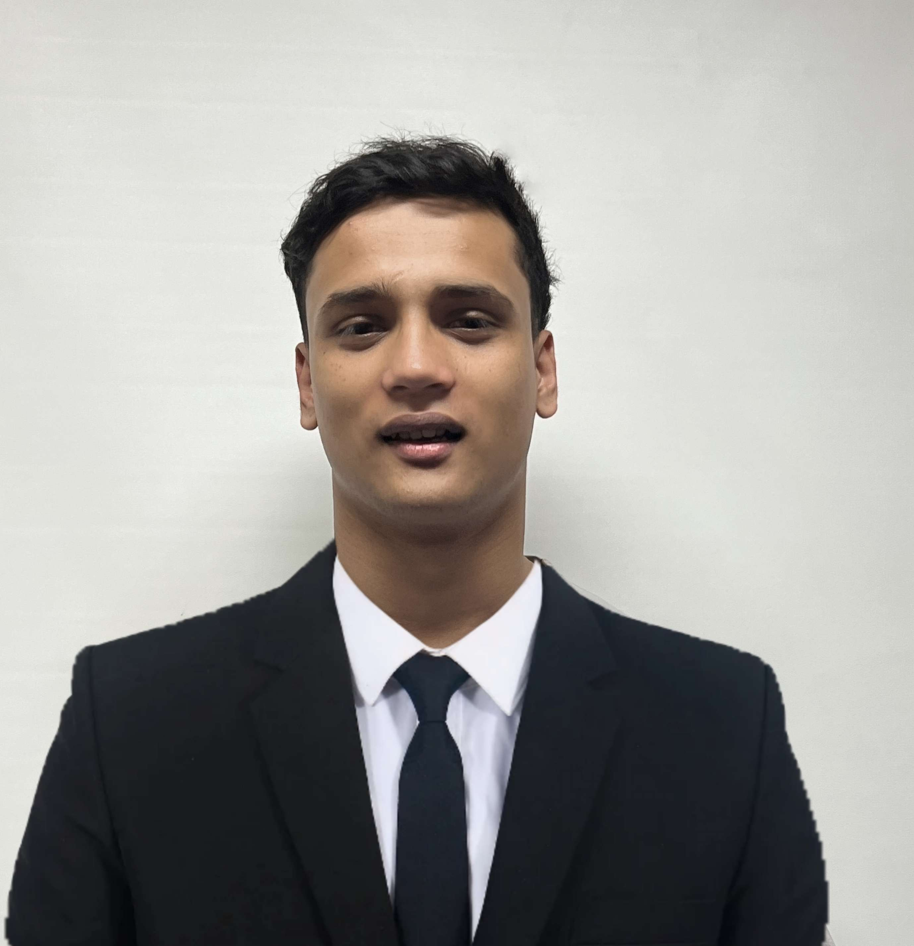

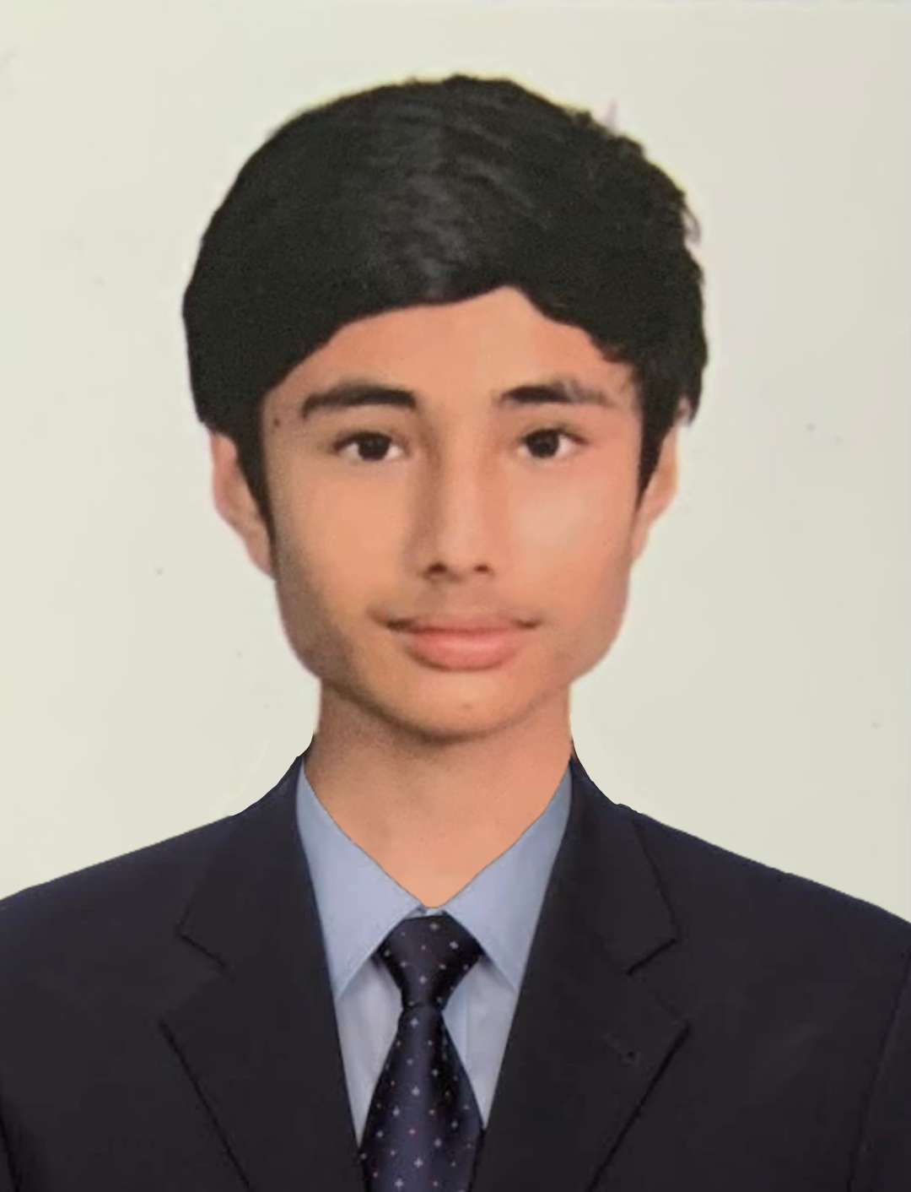

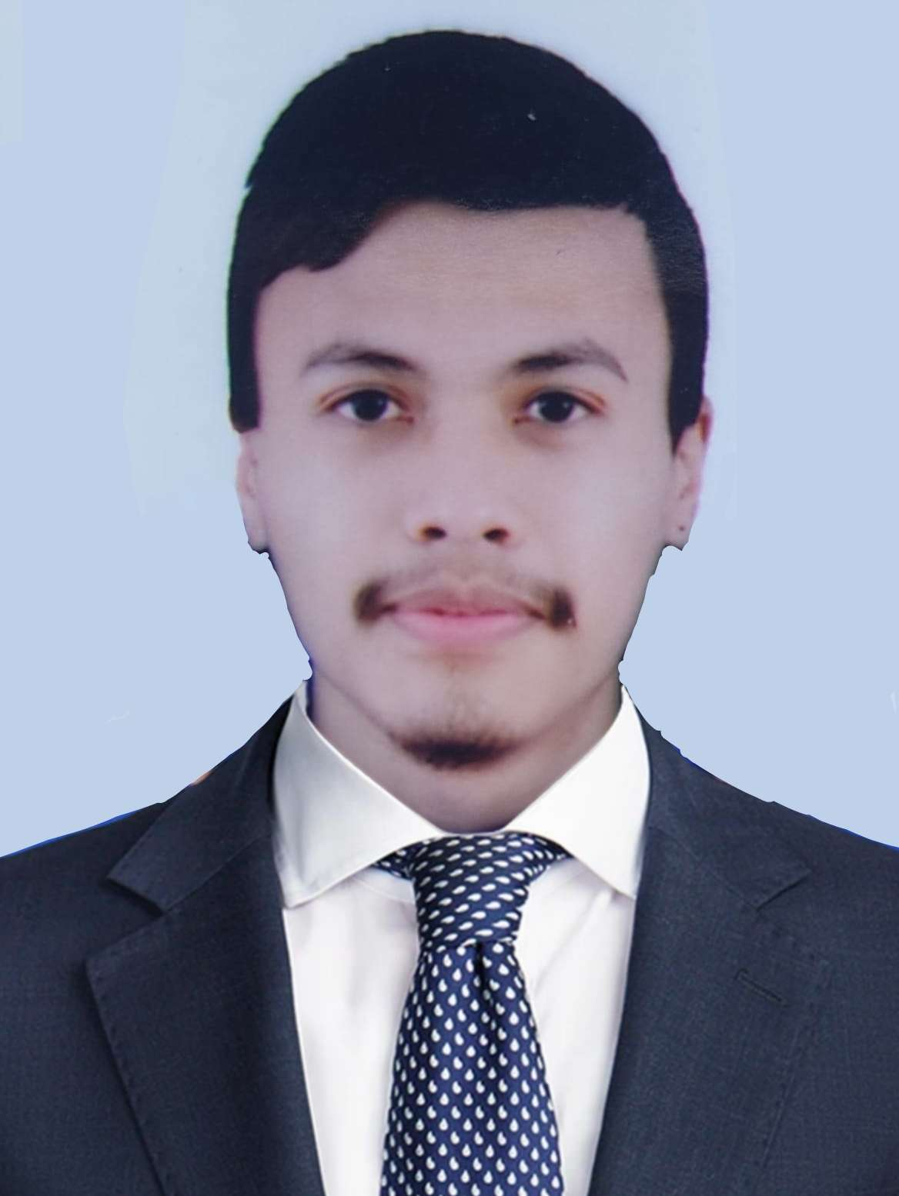
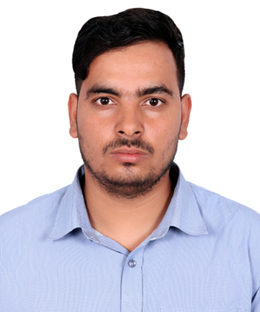
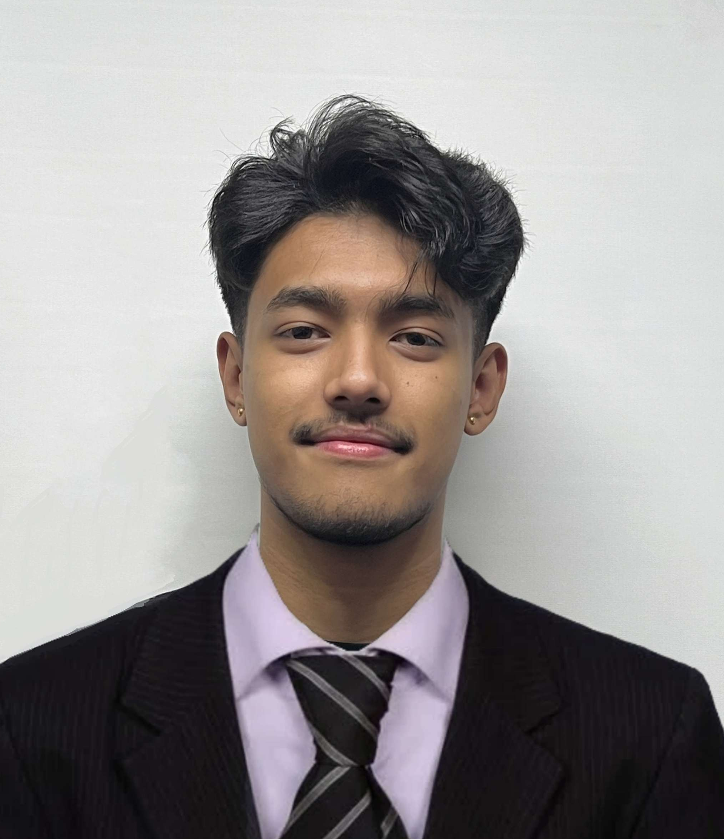
Meet our team
Abhishek Poudel
Plant
Shasank Shrestha
Amulya Shrestha
Co-Ordinator
Resource Investigator
Soya Shrestha
Team Worker
Biliyas Maharjan
Team Worker
Sushan Bhandari
Implementer
Biraj Shrestha
Co-Ordinator

Slide 3



Project Phases
PLANNING PHASE
INITIATION PHASE
EXECUTION PHASE

Slide 4

TABLE OF CONTENT
Time Scope
Project Charter
ERD
EERD
Composite EERD
Final Composite EERD
Use Cases (Customer, Trader, Admin, Overview)
MS-Project
Website Demonstration
4

Slide 5
TIME SCOPE
MEMBERS NAME | SLIDES COVERING | TIME

Slide 6
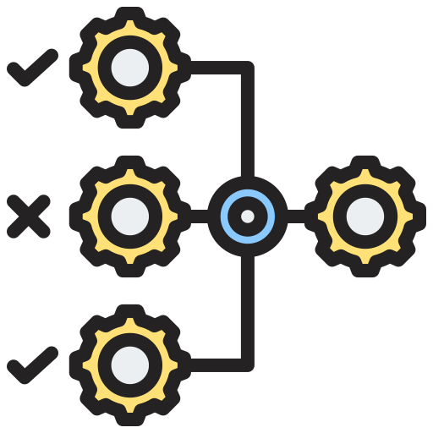





PROJECT CHARTER
Version Control
Estimated Budget
Project Justification
Duration
Project Scope
Roles and Responsibility

Slide 7





MS PROJECT
TIMELINE
RESOURCE SHEET
TASK SHEET
GANTT CHART
CALENDAR

Slide 8
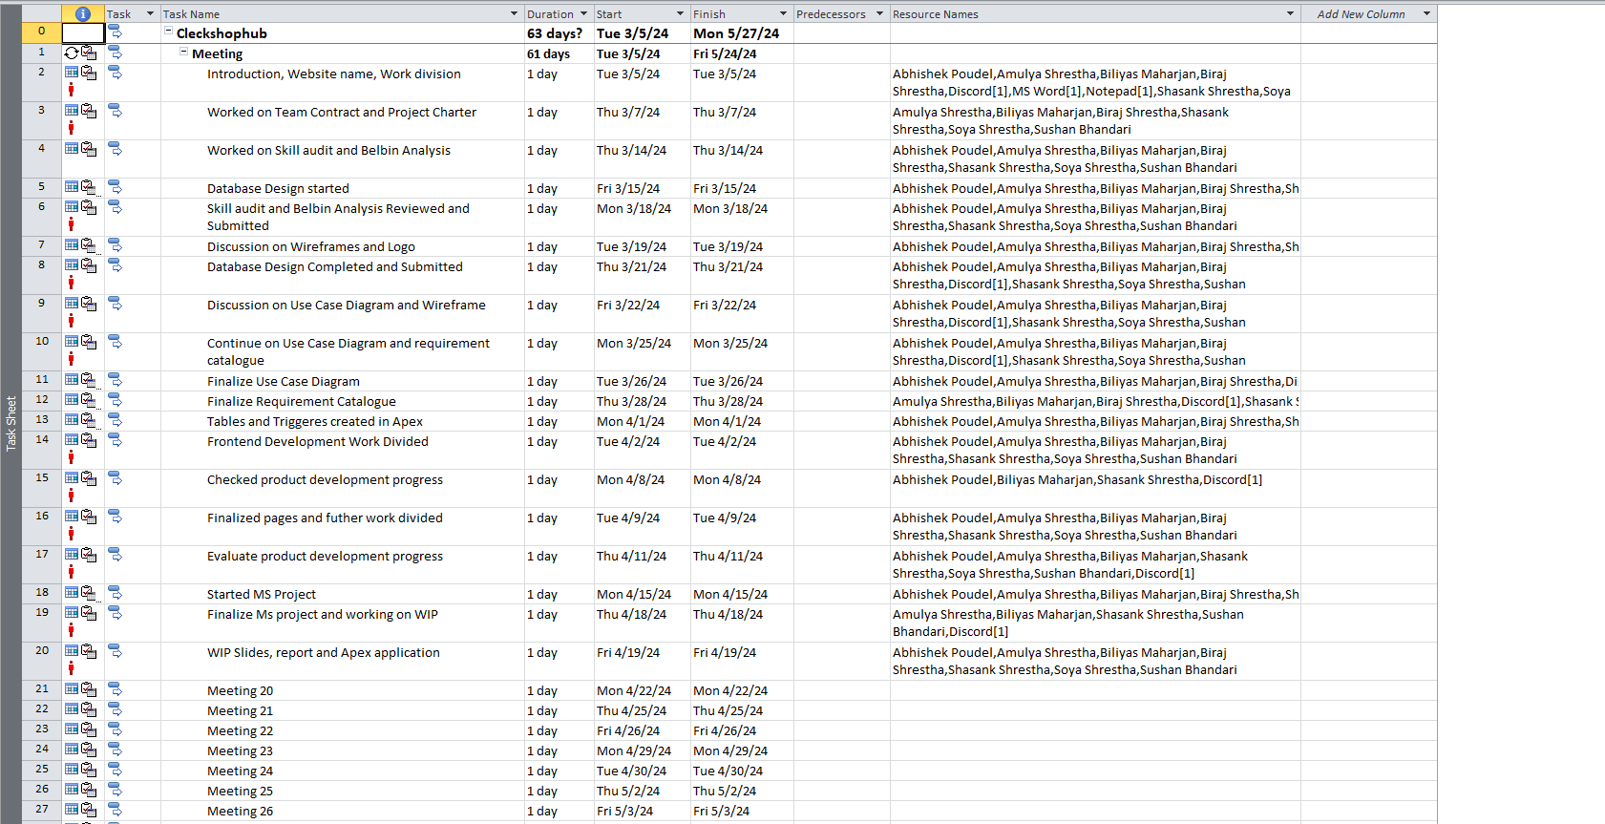
TASK SHEET
8

Slide 9
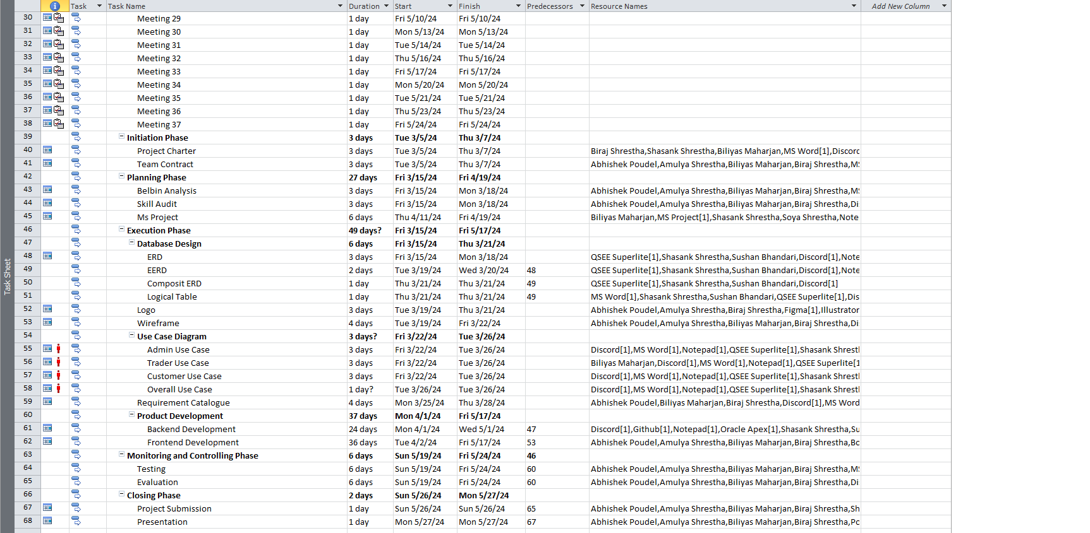
TASK SHEET
9

Slide 10
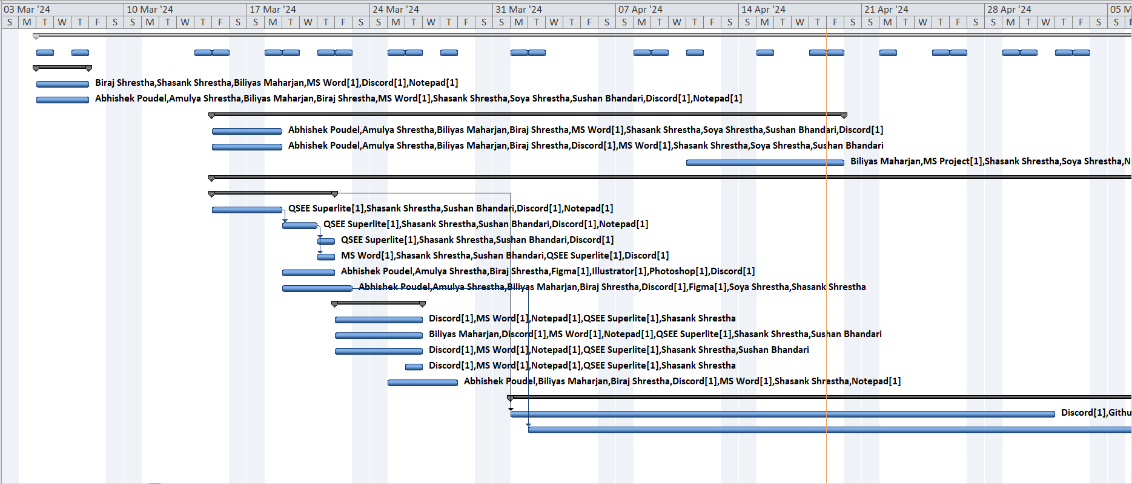
GANTT CHART
10

Slide 11
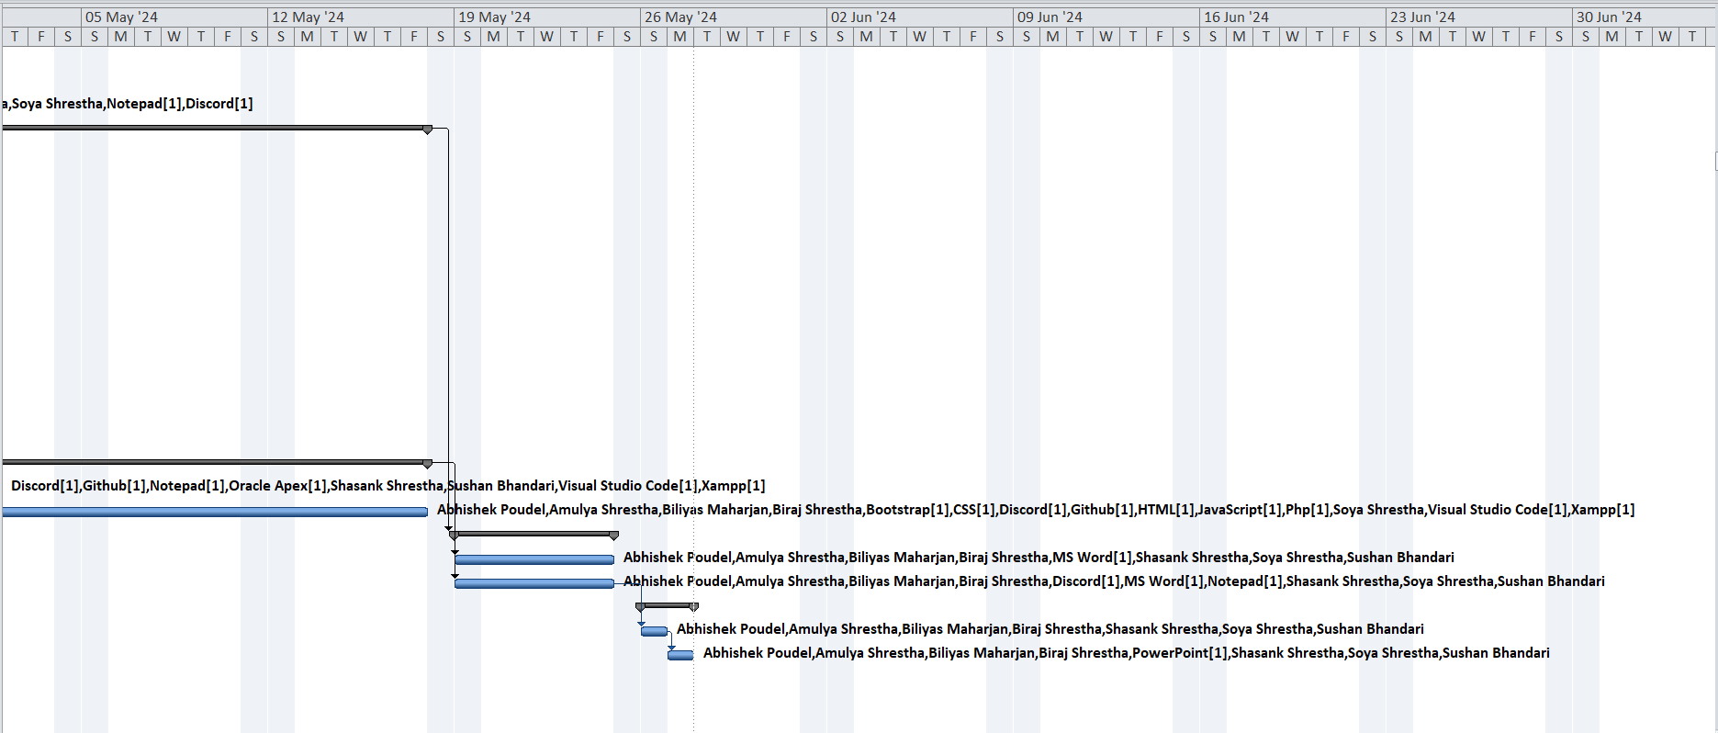
GANTT CHART
11

Slide 12
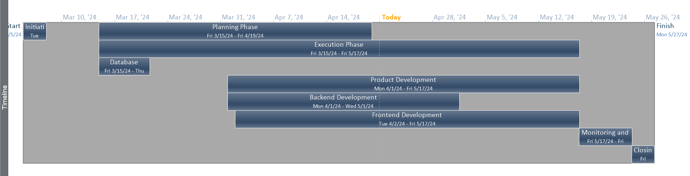
TIMELINE
12

Slide 13
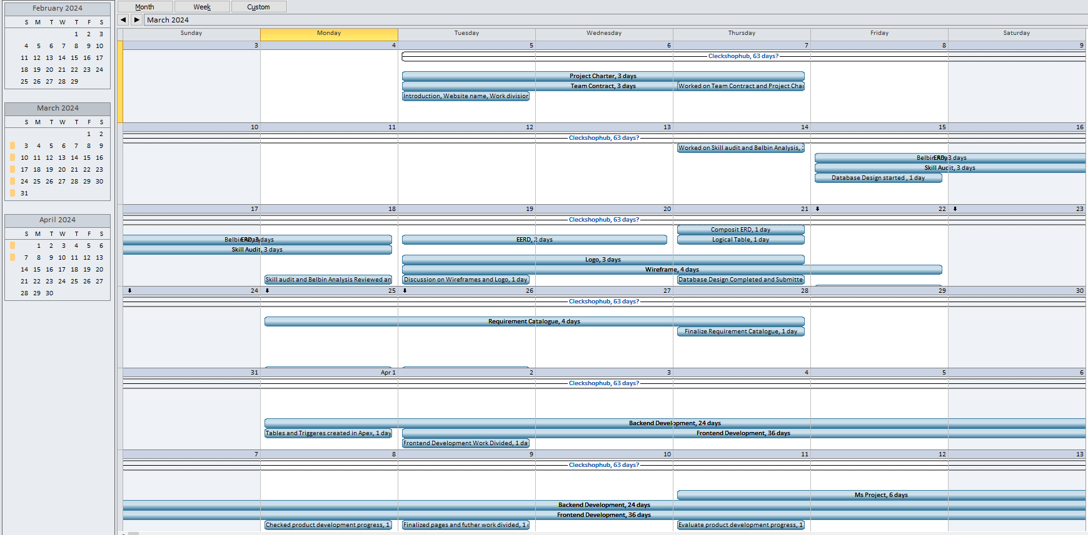
CALENDAR
13

Slide 14
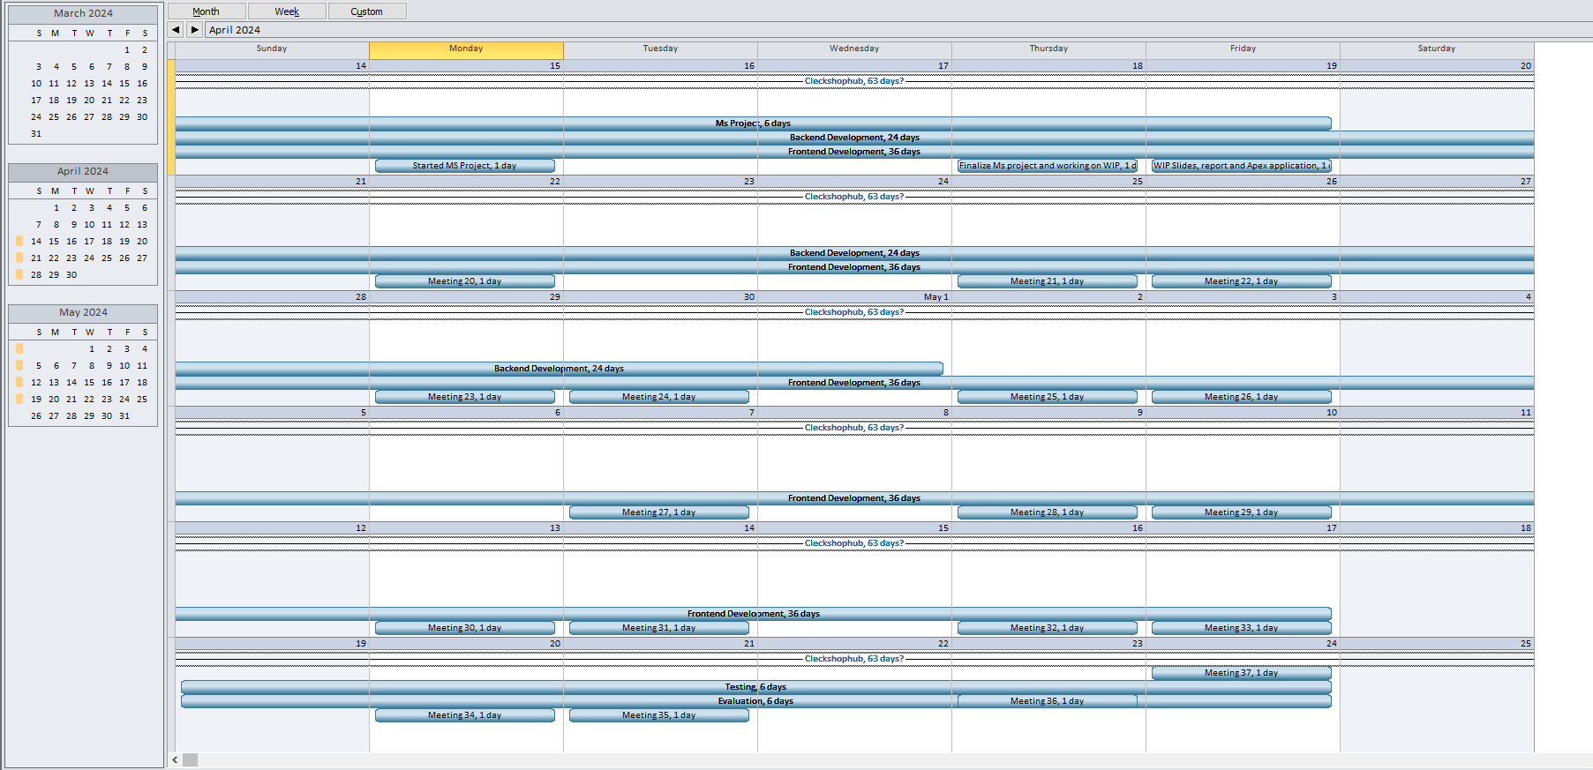
CALENDAR
14

Slide 15
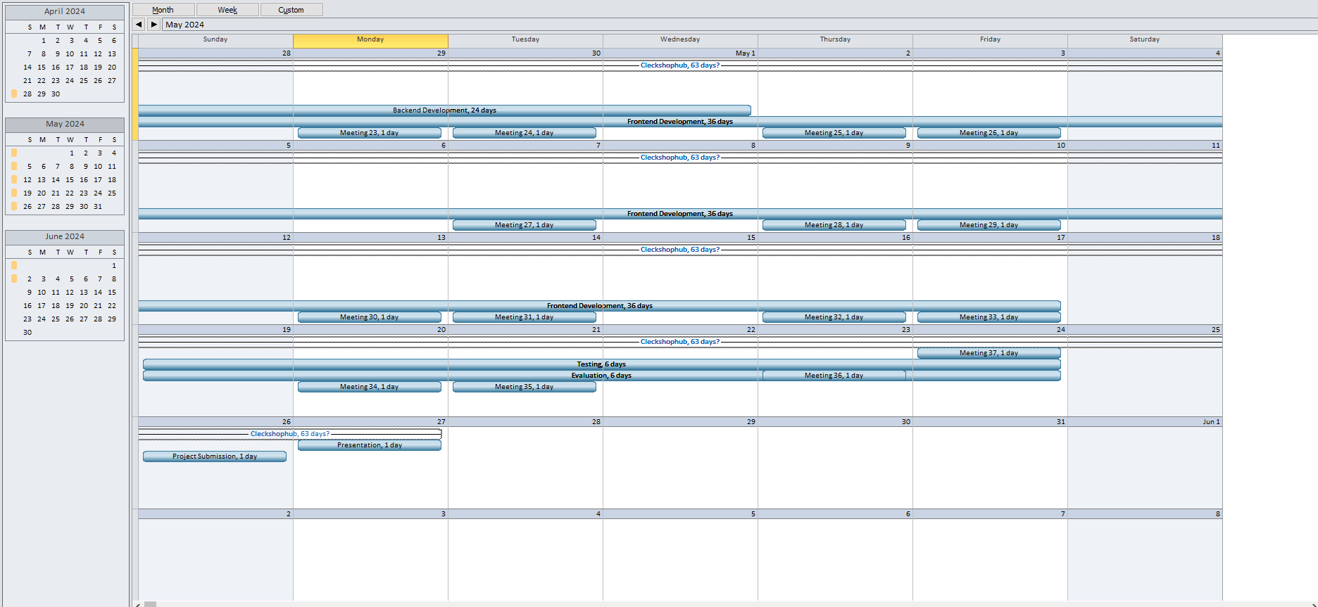
CALENDAR
15

Slide 16
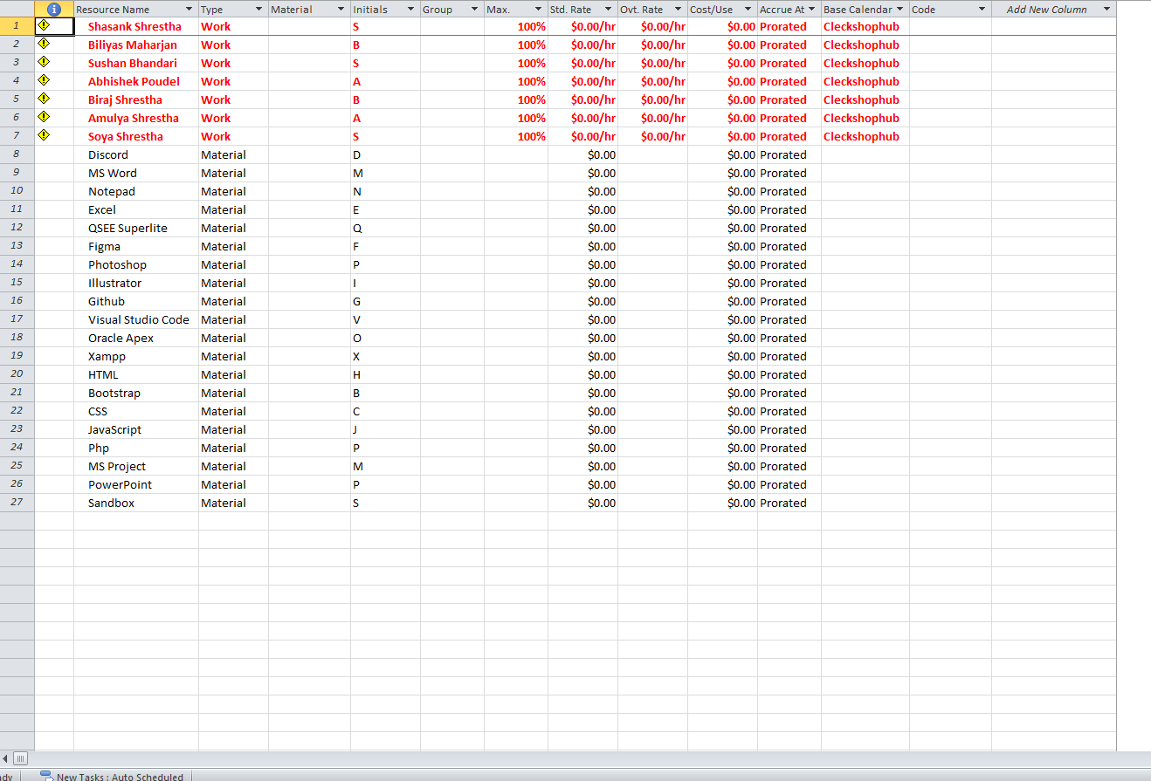
RESOURCE SHEET
16

Slide 17
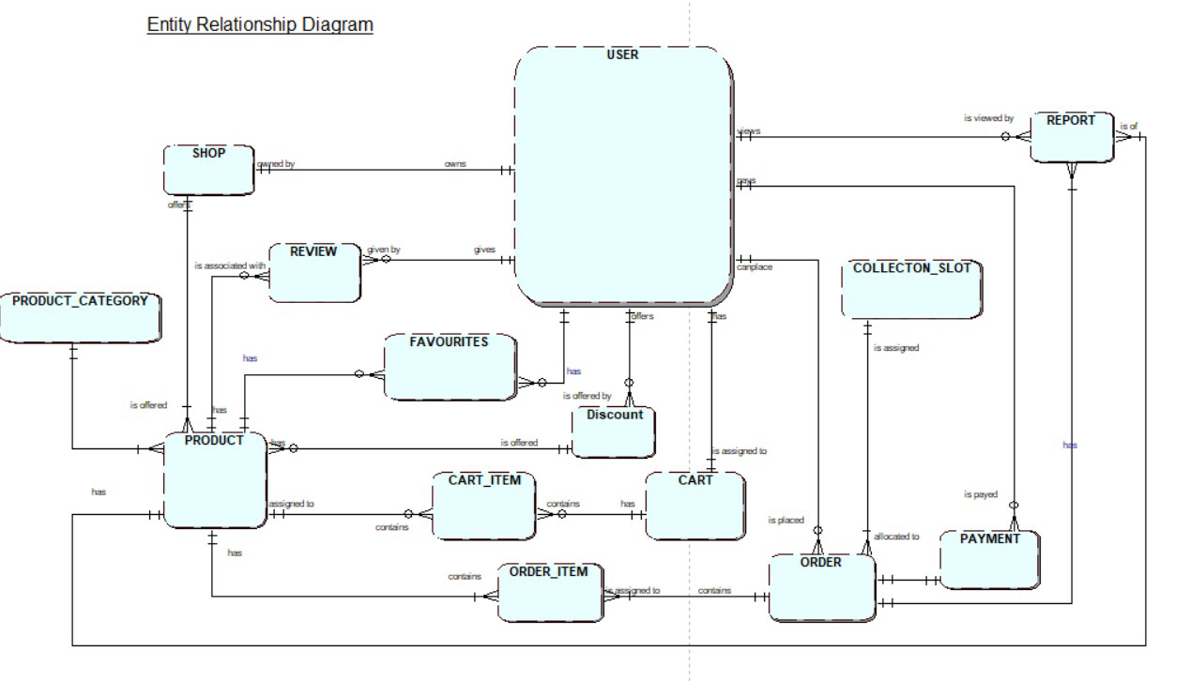
ERD

Slide 18
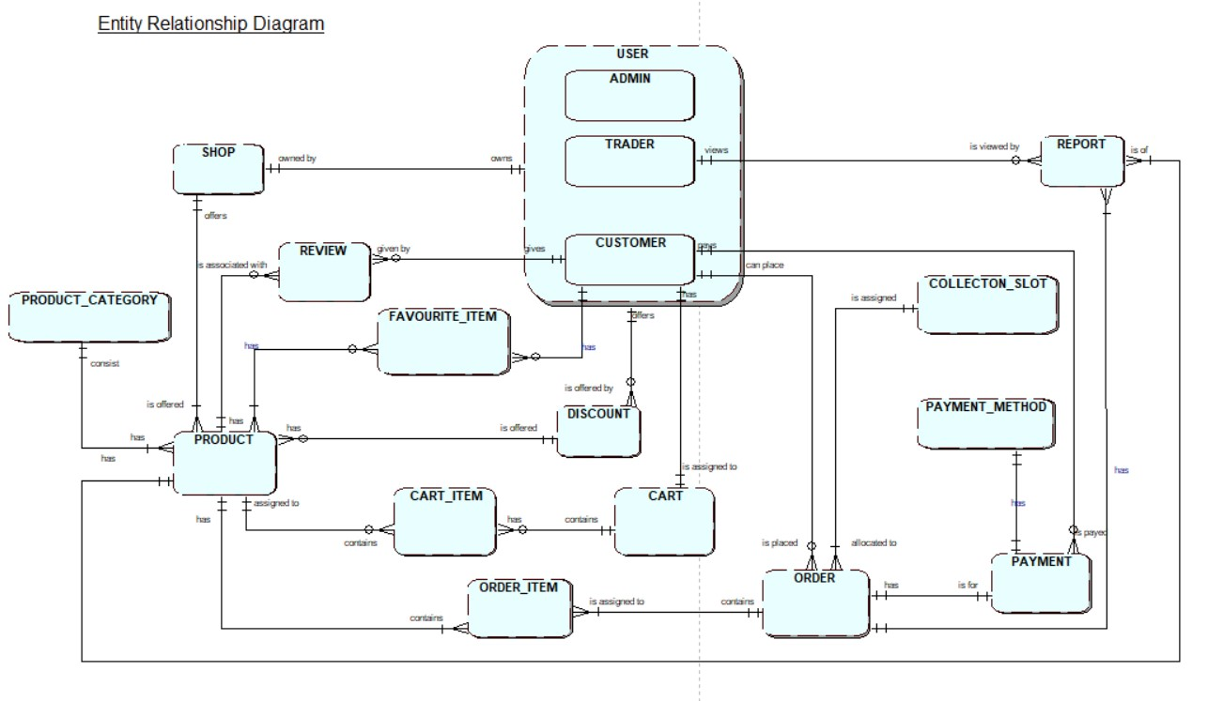
EERD

Slide 19
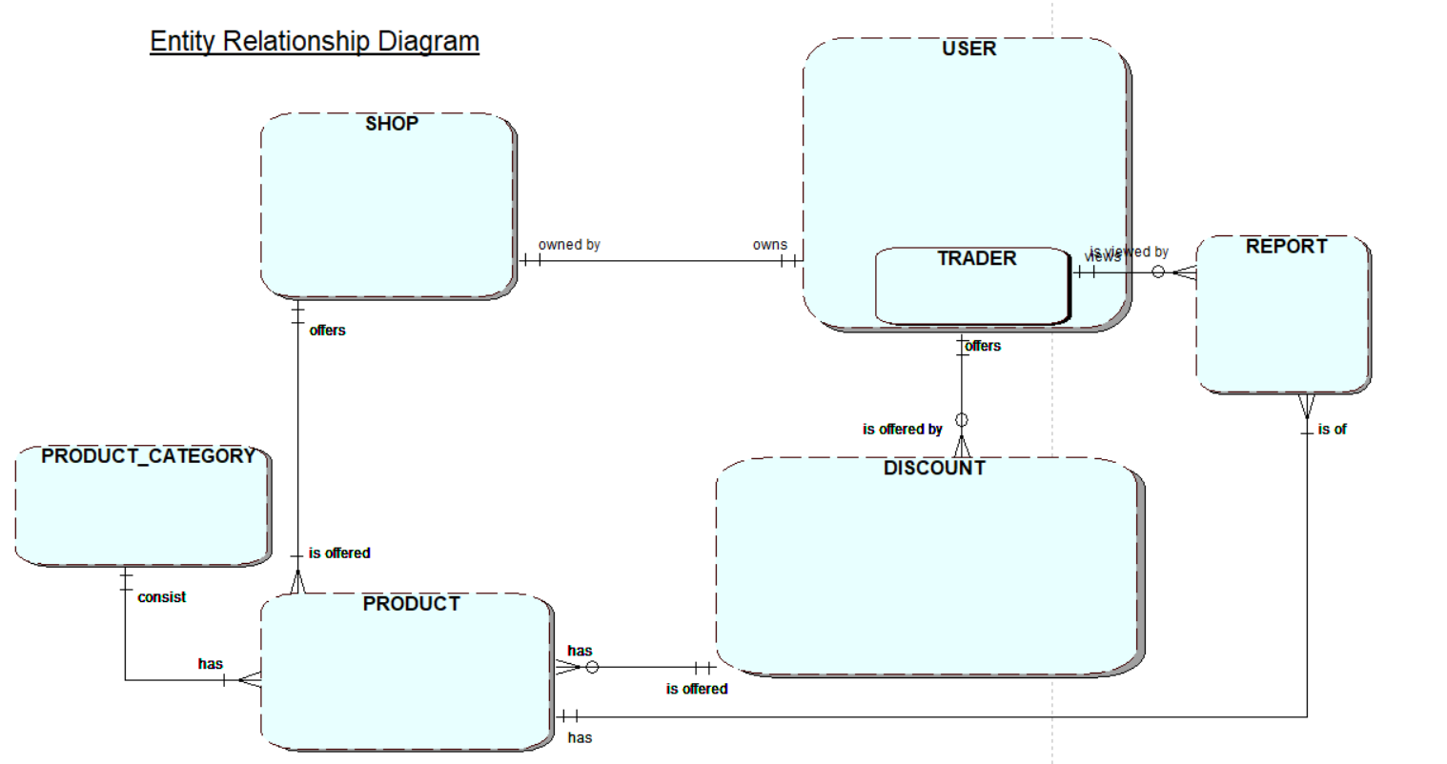
TRADER RELATION

Slide 20
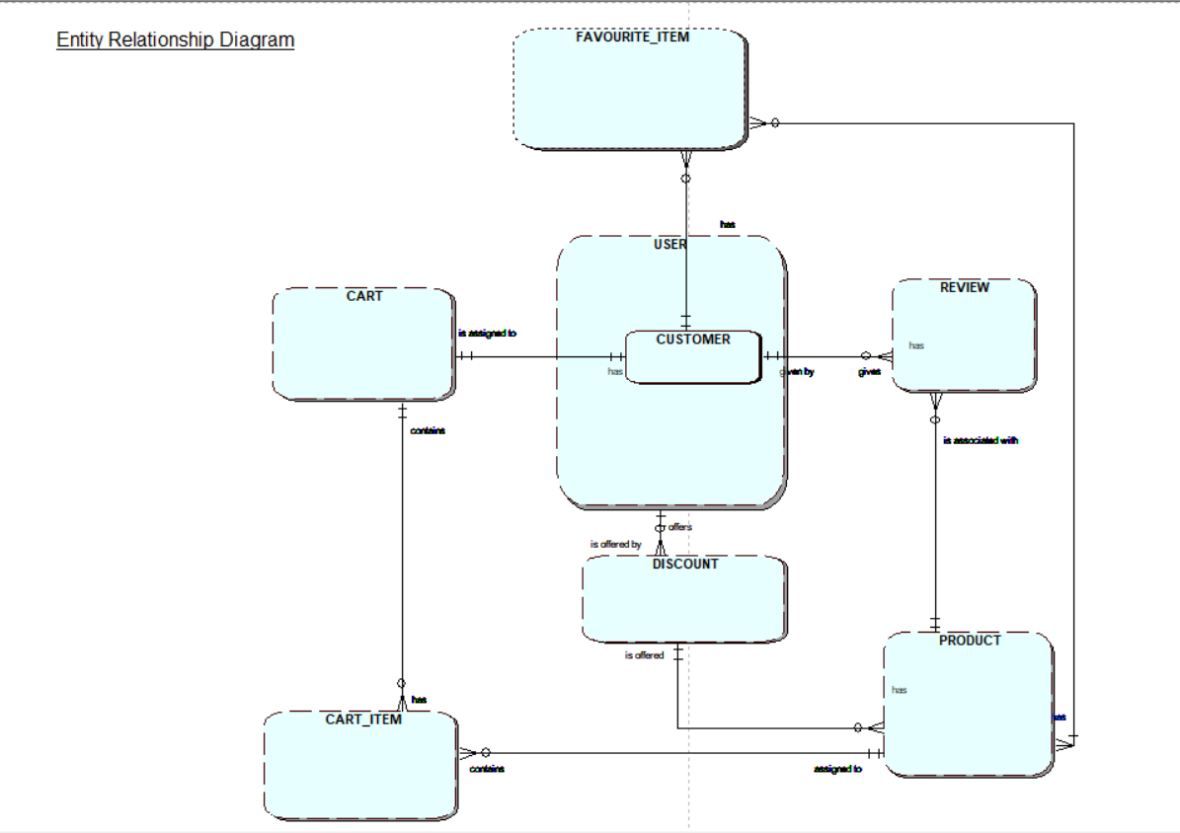
CUSTOMER RELATION

Slide 21
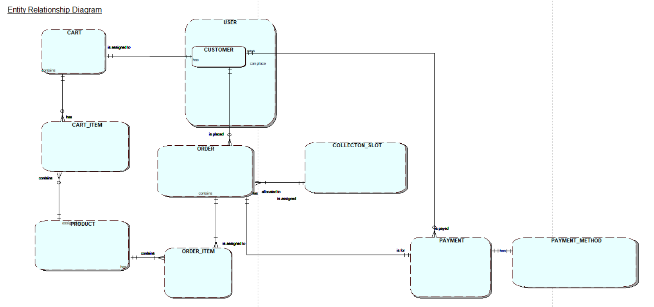
CUSTOMER RELATION

Slide 22
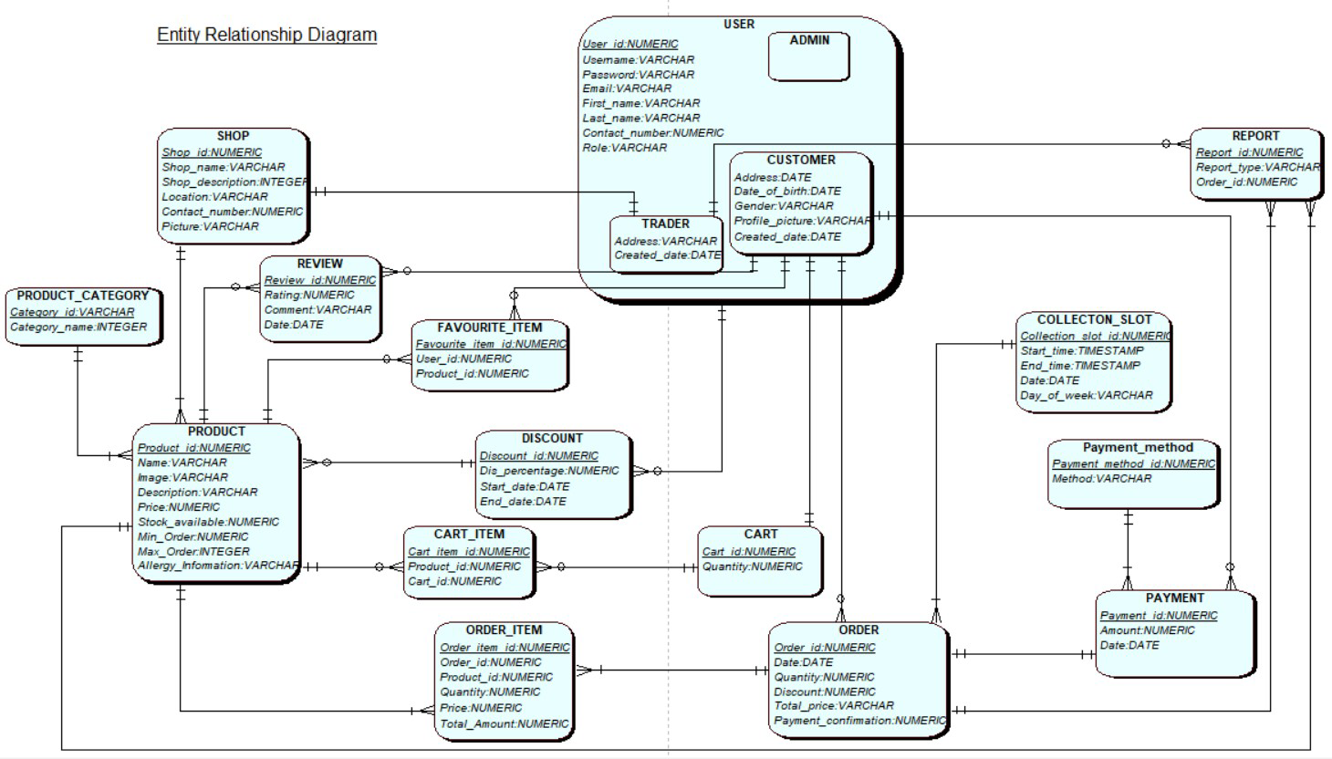
COMPOSITE ERD

Slide 23
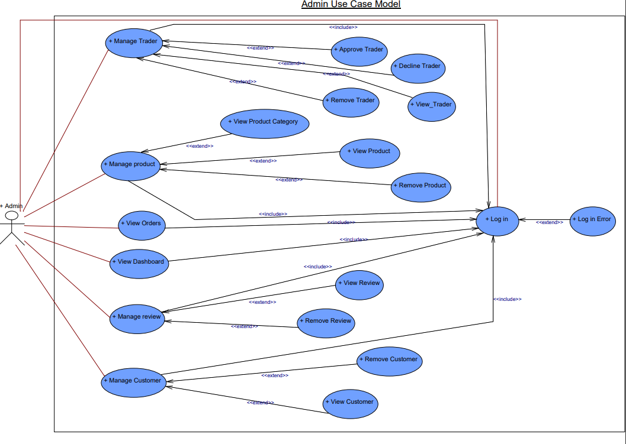
ADMIN USE CASE DIAGRAM

Slide 24
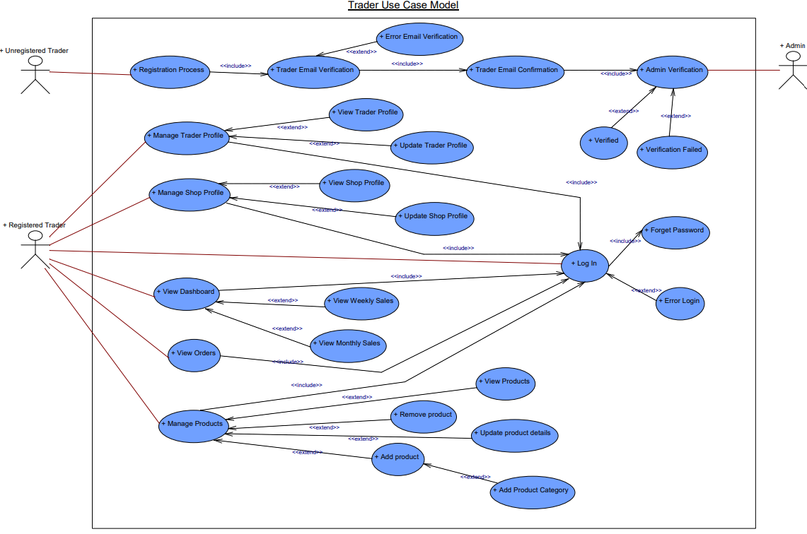
TRADER USE CASE DIAGRAM

Slide 25
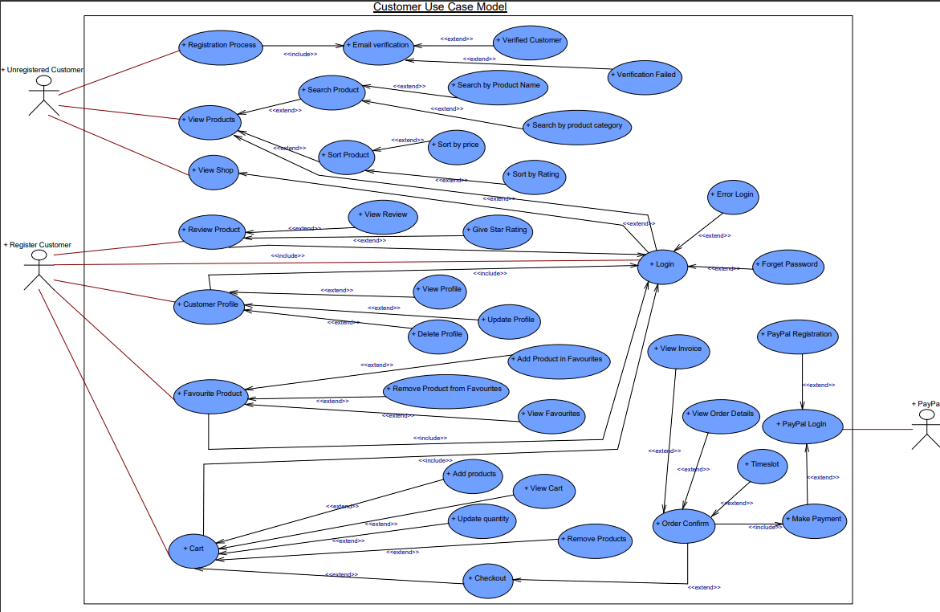
CUSTOMER USE CASE DIAGRAM

Slide 26

Website Demonstration
CLECKSHOPHUB
26

Slide 27
HOME PAGE

Slide 28
PRODUCT PAGE

Slide 29
USER PROFILE PAGE

Slide 30
CUSTOMER REGISTRATION PAGE

Slide 31




Thank you !

